Slide 1

Bayesian production models applied to North Atlantic Mako Sharks using JABBA and JABBA-Select, updated in 2026
Elizabeth A Babcock
SCRS/2026/149
Marine Biology and Ecology, Rosenstiel School of Marine, Atmospheric and Earth Science

Slide 2
Revisions Wednesday
JABBA-Select. Correcting typo in male Linf for scenario 2 made no visible differences
Identified a problem with the scaling in the current version of JABBA
https://github.com/jabbamodel/JABBA/issues
Reinstalled JABBA from 2025 and re-ran everything. Scale is much more reasonable.

Slide 3
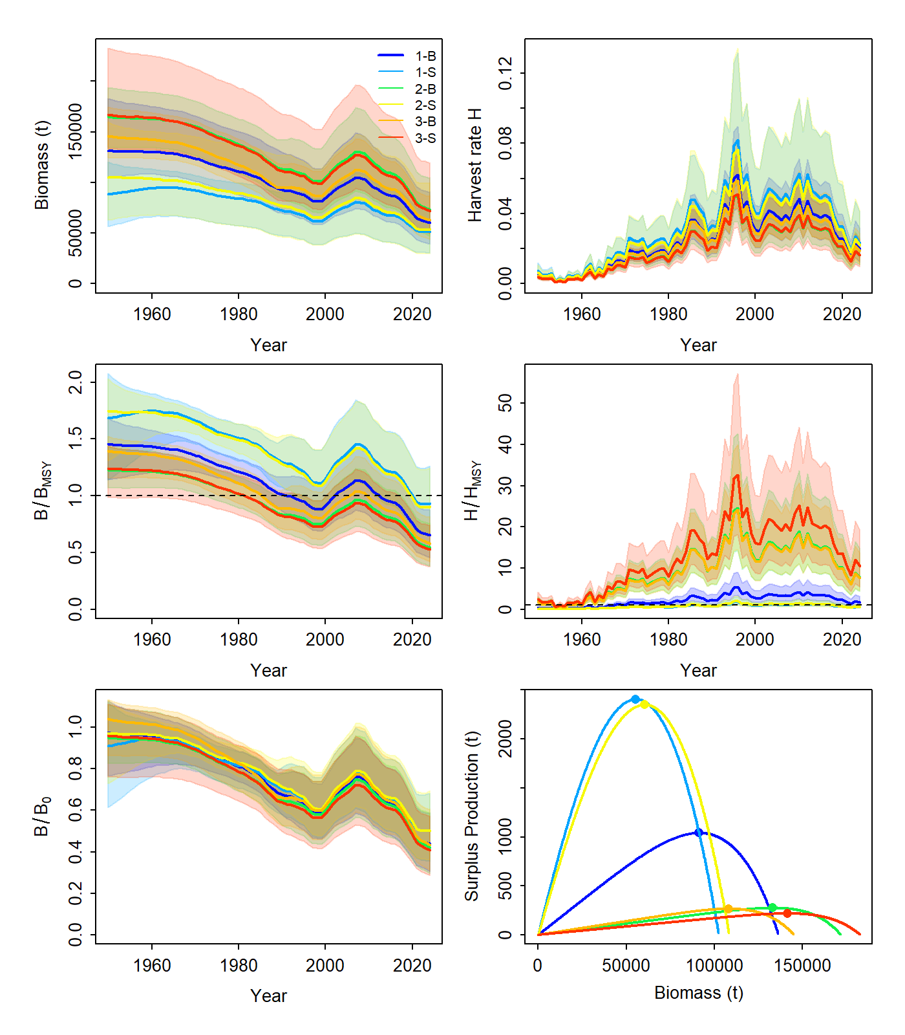
Results corrected
JABBA
Case | Scenario | r | Bmsy/K
Base | 1 | 0.051 | 0.670
 | 2 | 0.020 | 0.846
 | 3 | 0.019 | 0.745
Sensitivity | 1 | 0.102 | 0.541
 | 2 | 0.094 | 0.557
 | 3 | 0.015 | 0.793
Still have lower productivity with higher Bmsy/K,
Overall scale is much more reasonable (previously had SP of 50000)

Slide 4
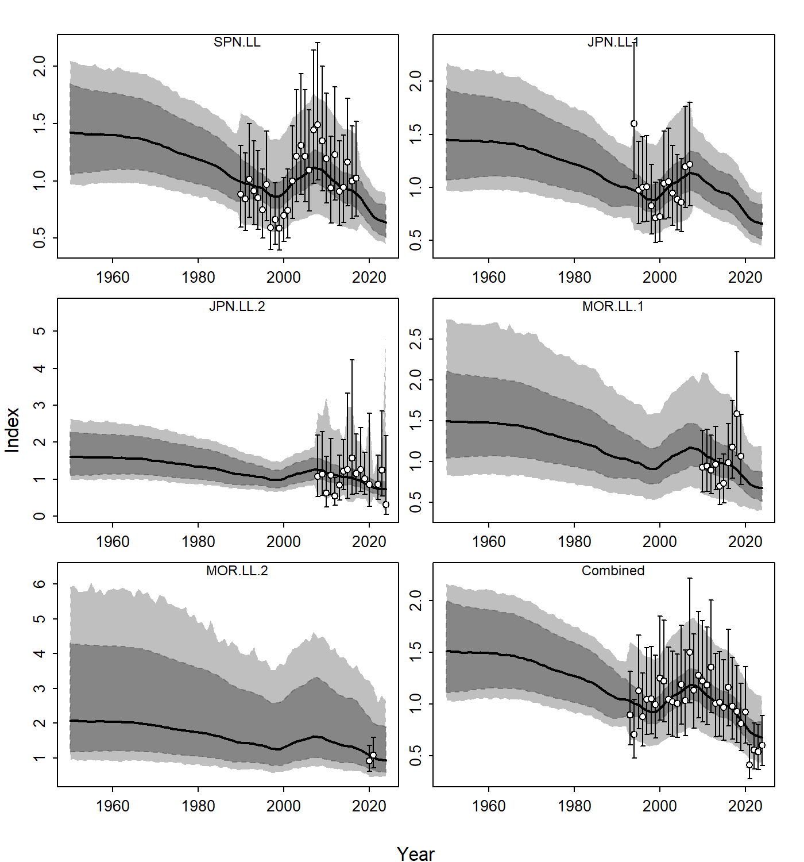
Fits similar for all, unchanged
JABBA

Slide 5
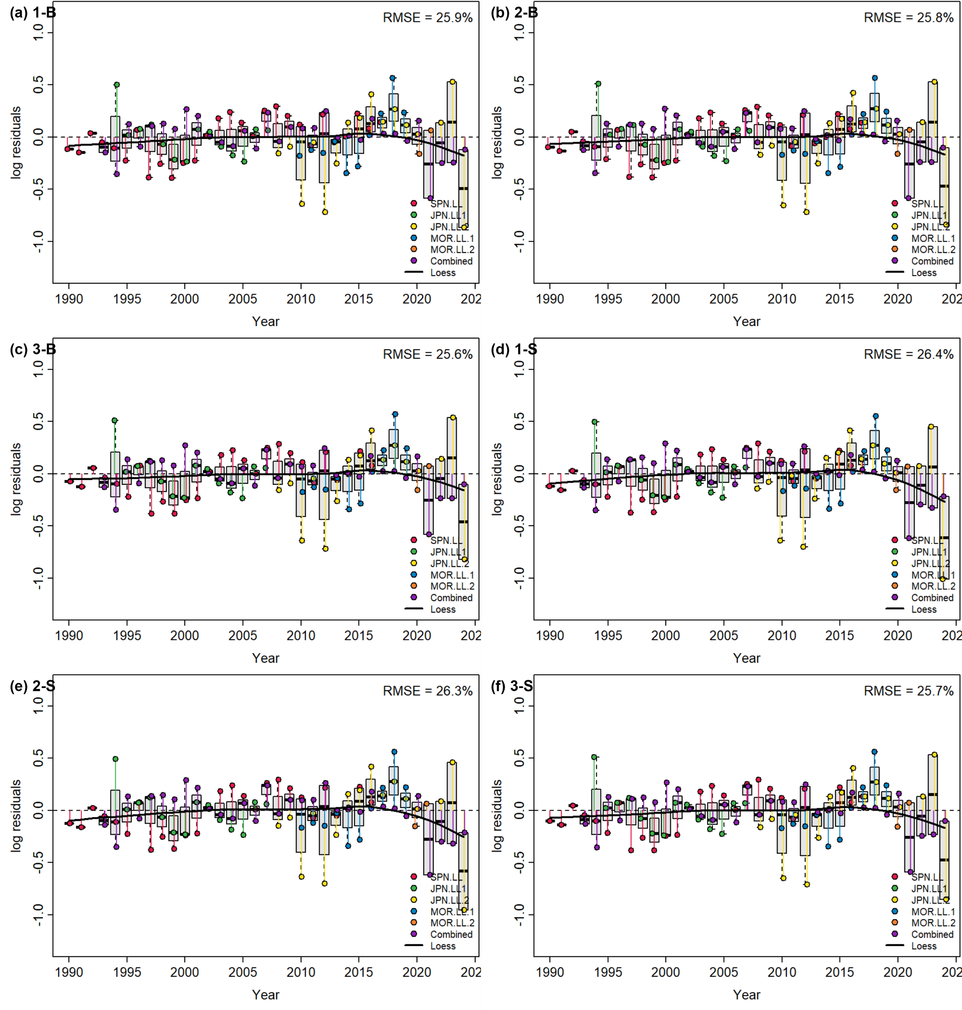
Fits

Slide 6
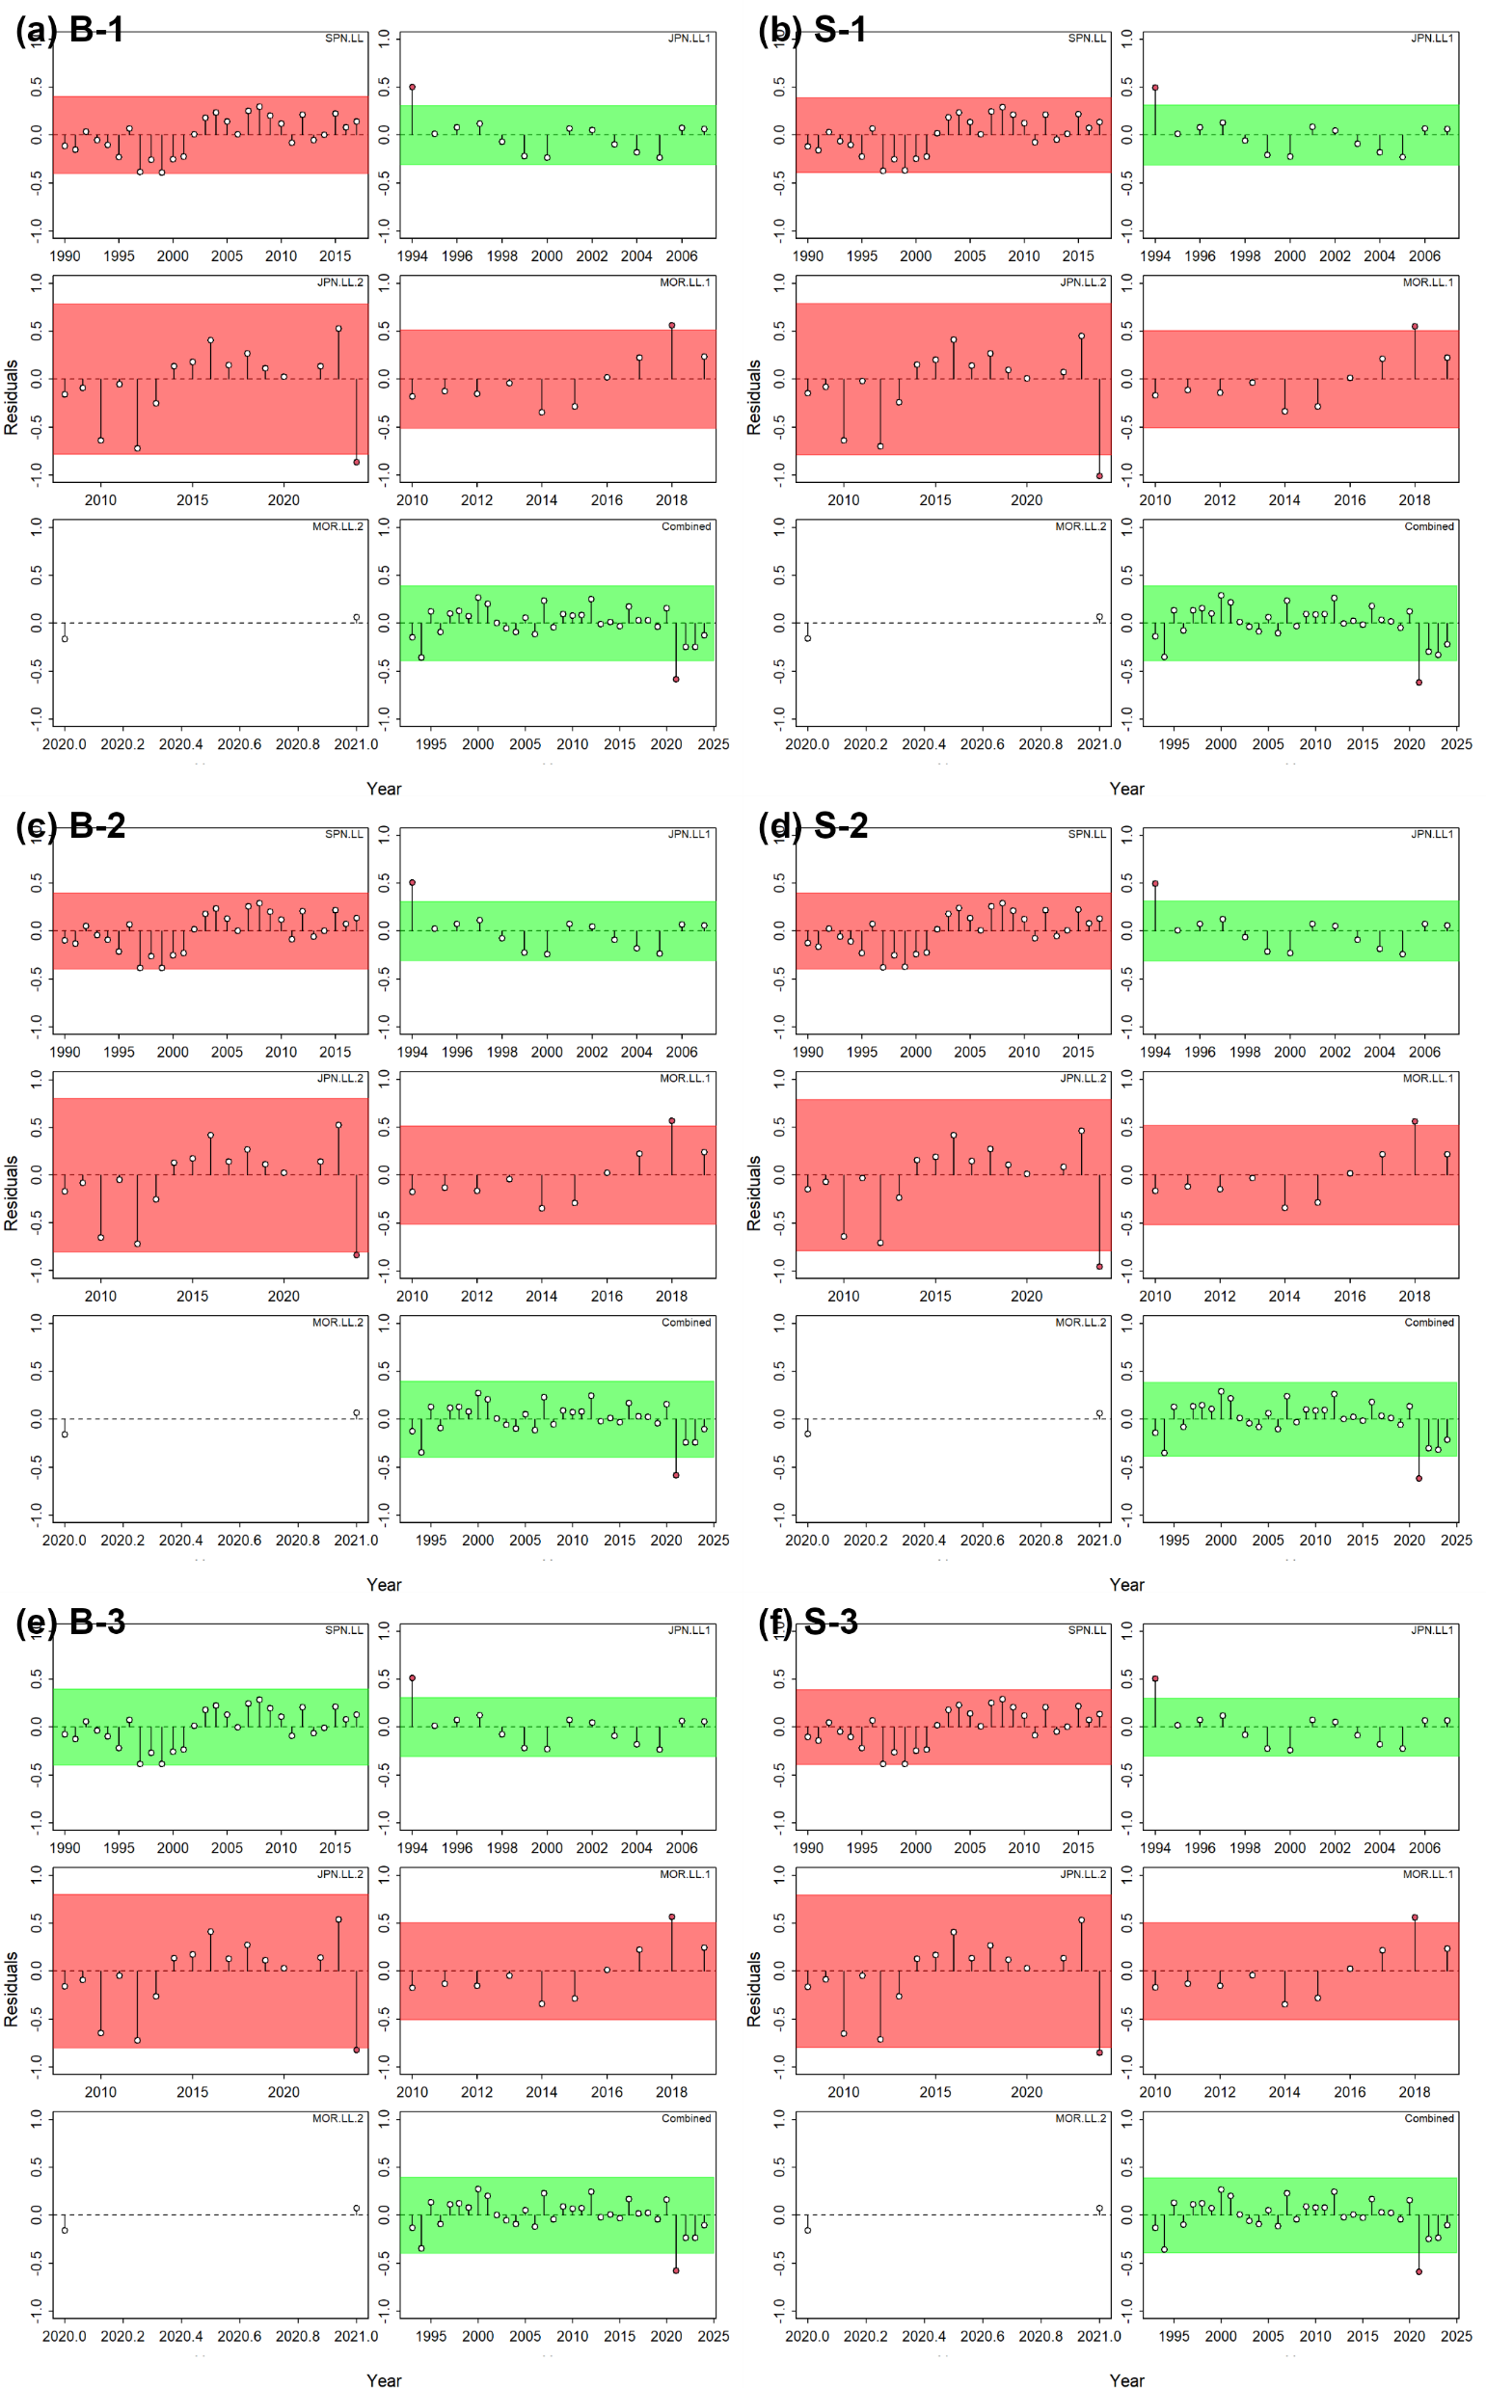
Trends in residuals
JABBA
SPN 1
JLL2
MOR2
JLL 1
MOR 1
Combined

Slide 7
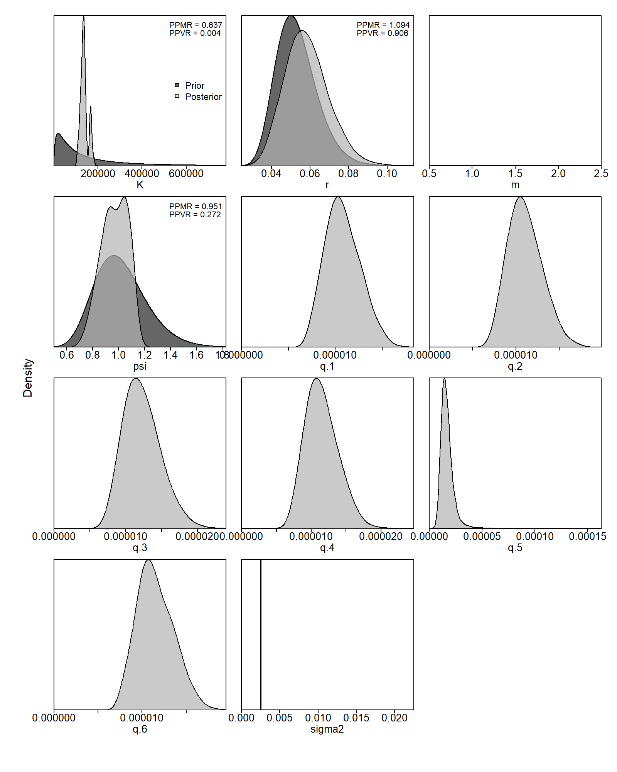
Prior (dark) and posterior (light) Base 1
JABBA

Slide 8
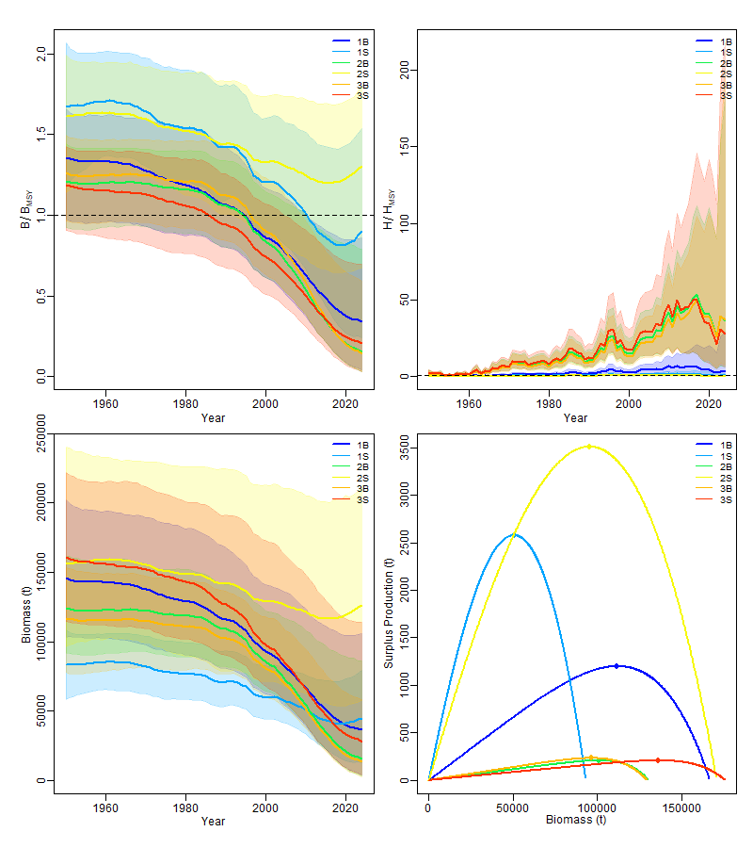
Catch only models (post model pre-data)
JABBA
Difference in productivity is driven by r priors and Bmsy/K

Slide 9
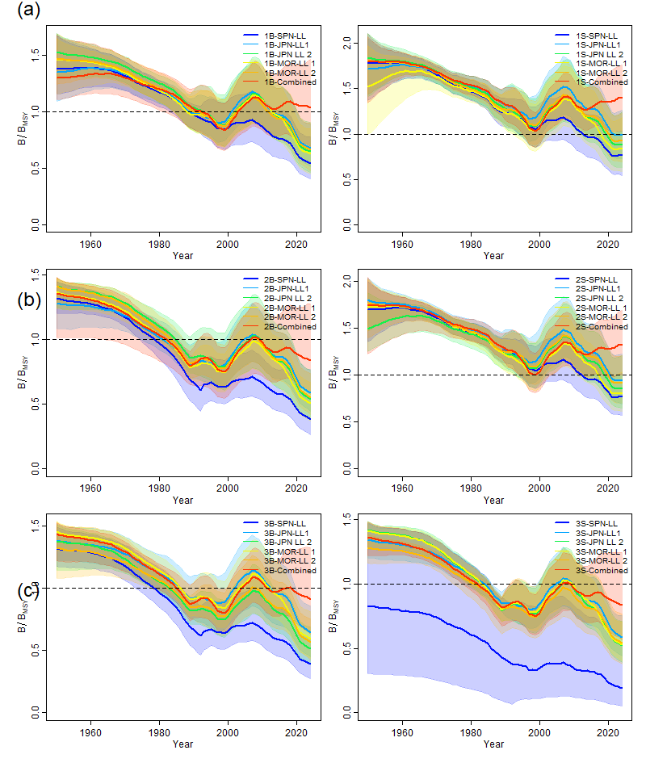
Runs leaving out one index
Without combined (red), it is more optimistic in recent years
Without Spain (blue), trend is more flat

Slide 10
Series one at a time
Without combined (red), it is more optimistic in recent years
Without Spain (blue), trend is more flat

Slide 11
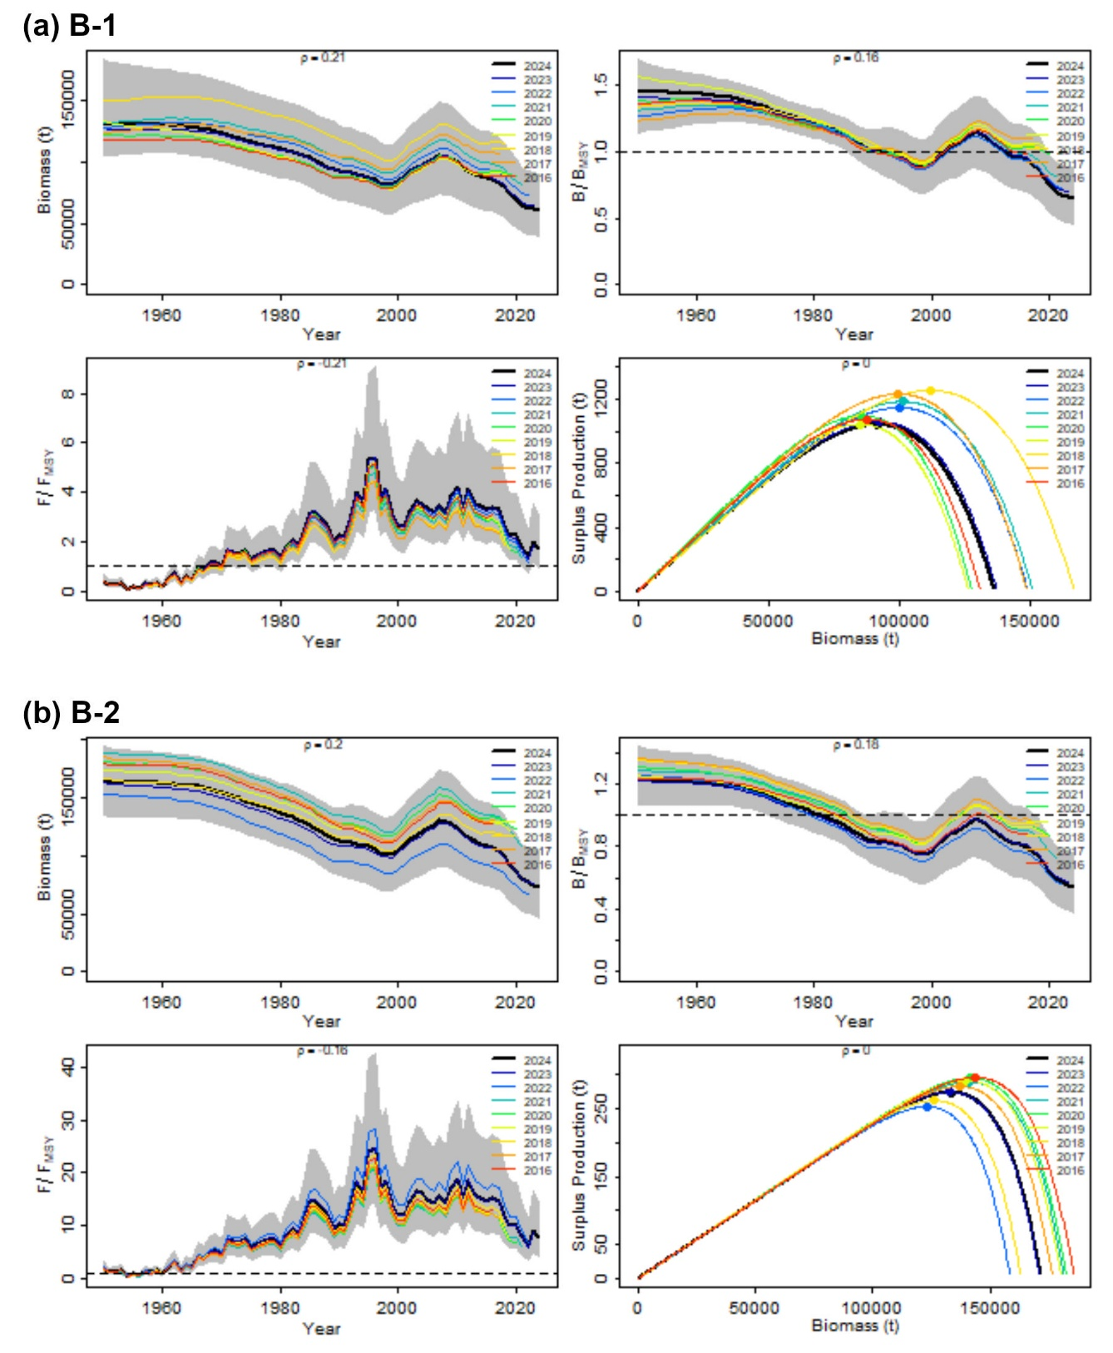

Retrospective bias
JABBA
Mohn’s Rho
Scen ario | B | F | Bmsy | Fmsy | procB | MSY
B1 | 0.21 | -0.17 | 0.16 | -0.21 | 0.03 | 0.09
B2 | 0.20 | -0.15 | 0.18 | -0.16 | 0.02 | 0.02
B3 | 0.23 | -0.18 | 0.13 | -0.20 | 0.02 | 0.12
S1 | 0.22 | -0.17 | 0.18 | -0.28 | 0.03 | 0.19
S2 | 0.15 | -0.10 | 0.15 | -0.20 | 0.03 | 0.07
S3 | 0.23 | -0.17 | 0.15 | -0.17 | 0.02 | 0.03
Same trend but some shift in scale

Slide 12
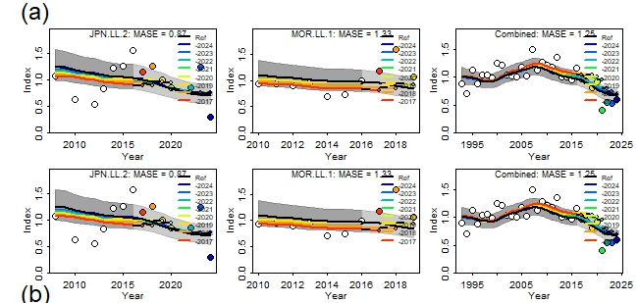
Hindcasts scenario base 1 and selectivity 1
JABBA

Slide 13
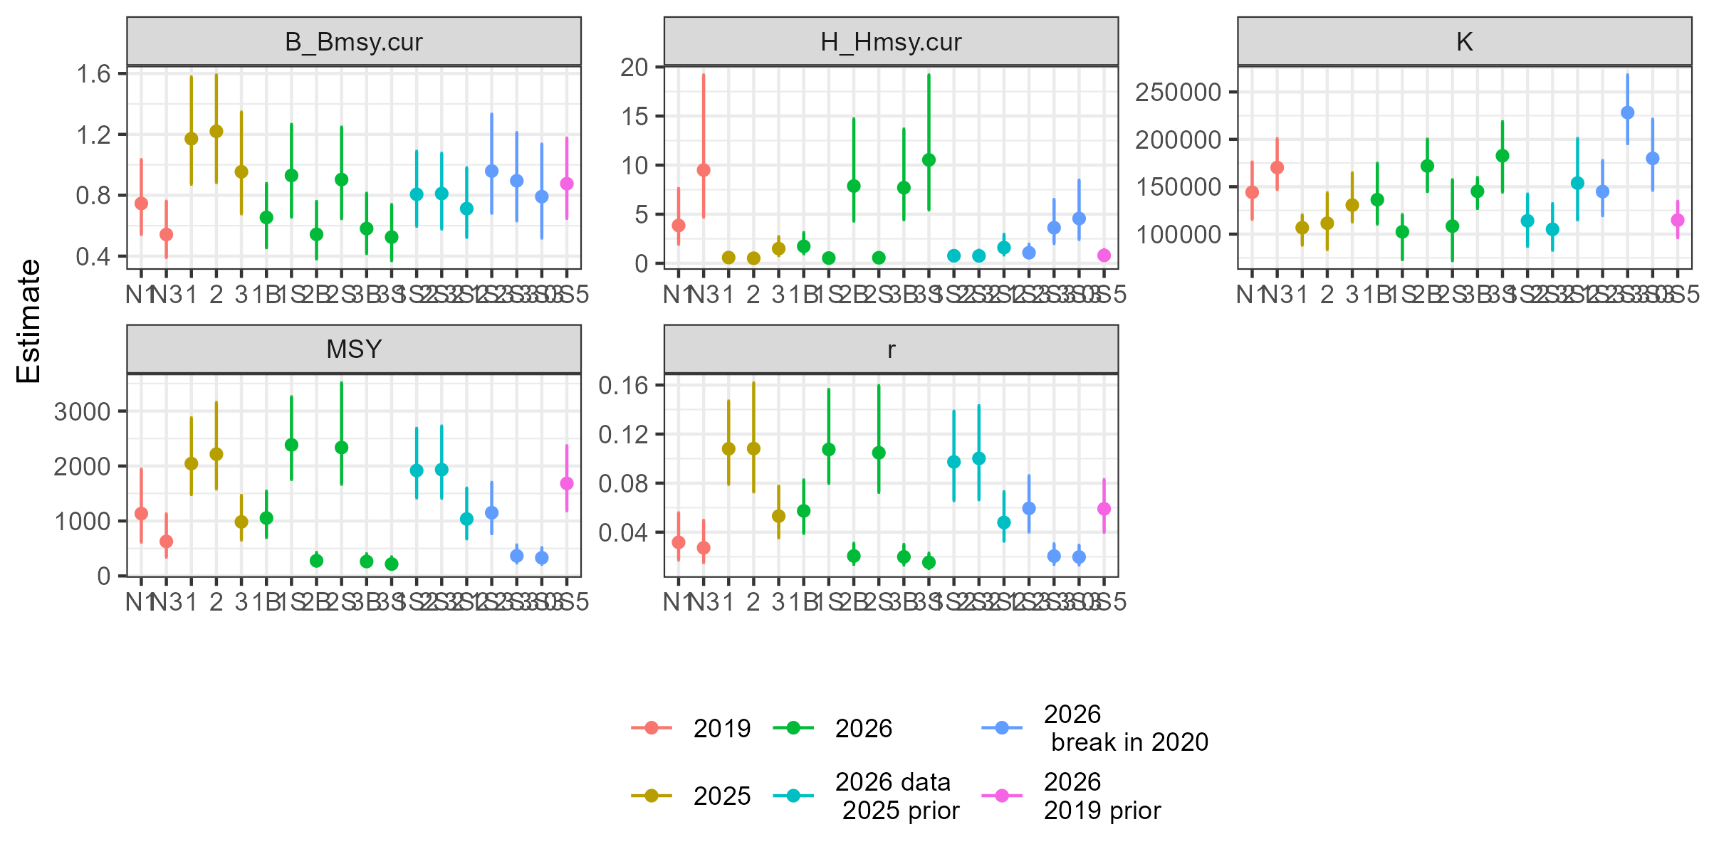
Comparison to 2025
JABBA
Case | Scenario | r | Bmsy/K
Base | 1 | 0.051 | 0.670
 | 2 | 0.020 | 0.846
 | 3 | 0.019 | 0.745
Sensitivity | 1 | 0.102 | 0.541
 | 2 | 0.094 | 0.557
 | 3 | 0.015 | 0.793

Slide 14
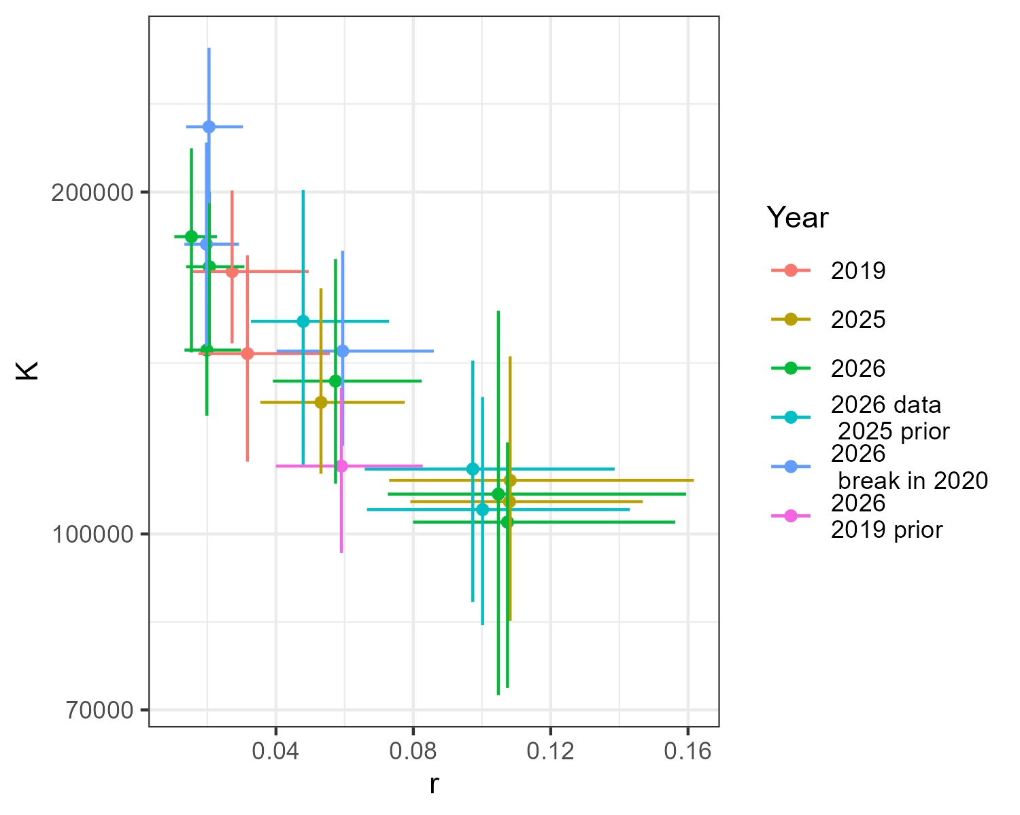
K and r posteriors across runs
JABBA

Slide 15
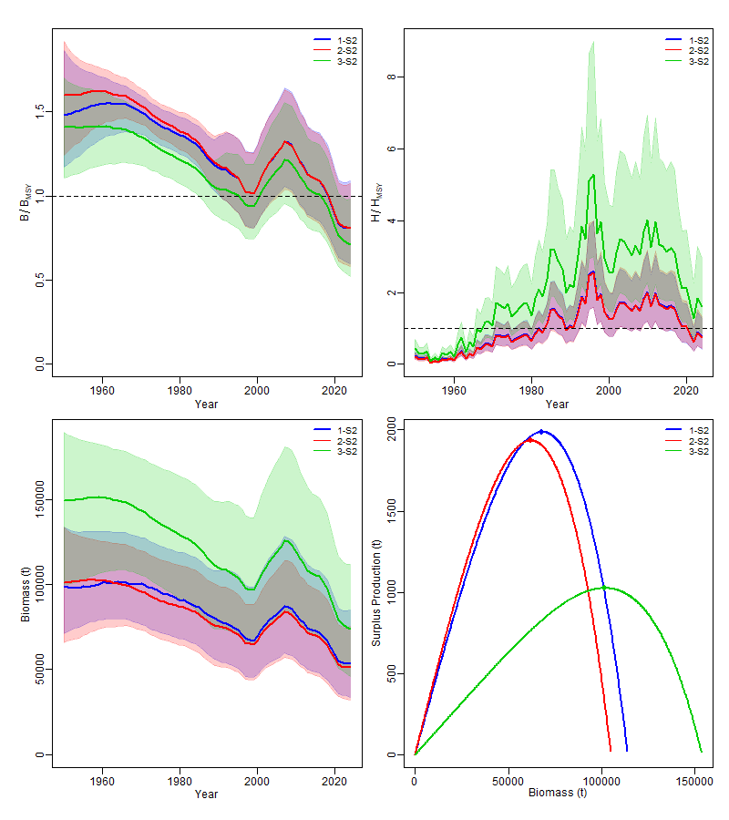
With 2025 priors

Slide 16
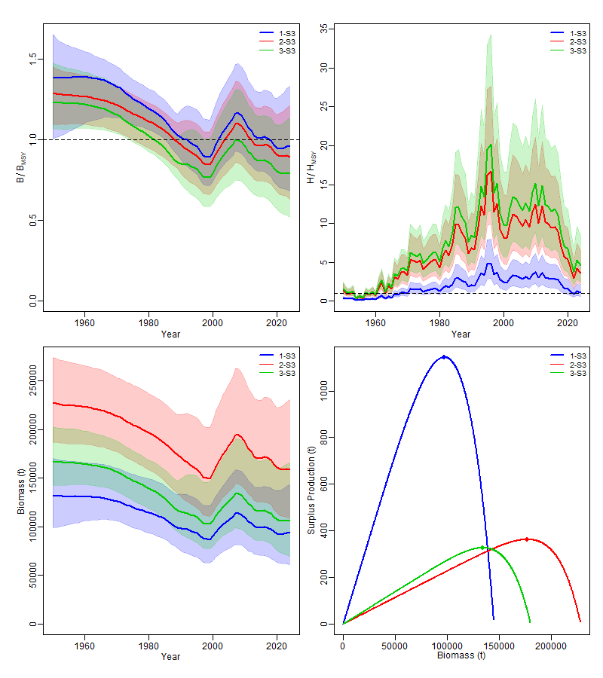
With break 2020-2021

Slide 17
Conclusions for JABBA and JABBA select
The models consistently fit the down-up-down trend in the indices.
JABBA is very sensitive to assumed Bmsy/K
The scale of the population is uncertain and dependent on life history assumptions, especially in JABBA.
Scale is reasonable when run with a stable version of JABBA

